Slide 1

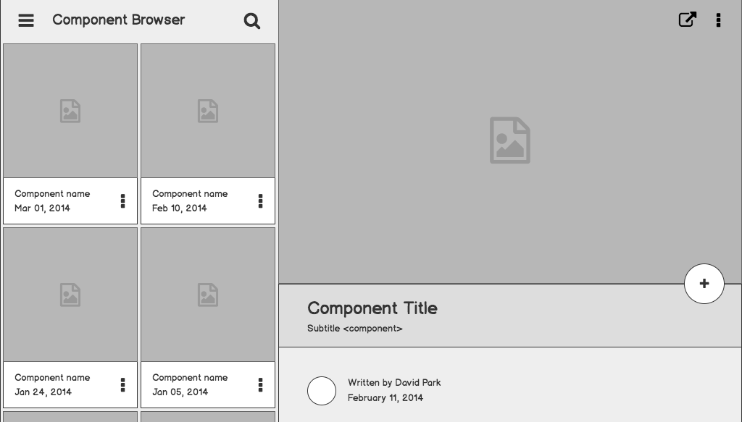
E-commerce KPI Dashboard & Analytics

Slide 2
Group 5
Naman Bhatnagar - 230940125030
Rishabh Raj Jaiswal 230940125040
Pratik Wankhade 230940125055
Kartik Moyade 230940125024
Mukul Dhote 230940125014

Slide 3
Introduction to Data and Data Pre-processing

Slide 4
About Data
Olist is the largest department store in Brazilian marketplaces.It connects small businesses from all over Brazil to enable them to sell their products through the Olist Store and ship them directly to the customers through Olist logistics partners
The dataset is a Brazilian ecommerce public dataset of orders made at Olist Store
The dataset has information of 100k orders from 2016 to 2018 made at multiple marketplaces in Brazil
Its features allows viewing an order from multiple dimensions: from order status, price, payment and freight performance to customer location, product attributes and reviews by customers
It is real commercial data- which has been anonymised

Slide 5

Data Connection

Slide 6
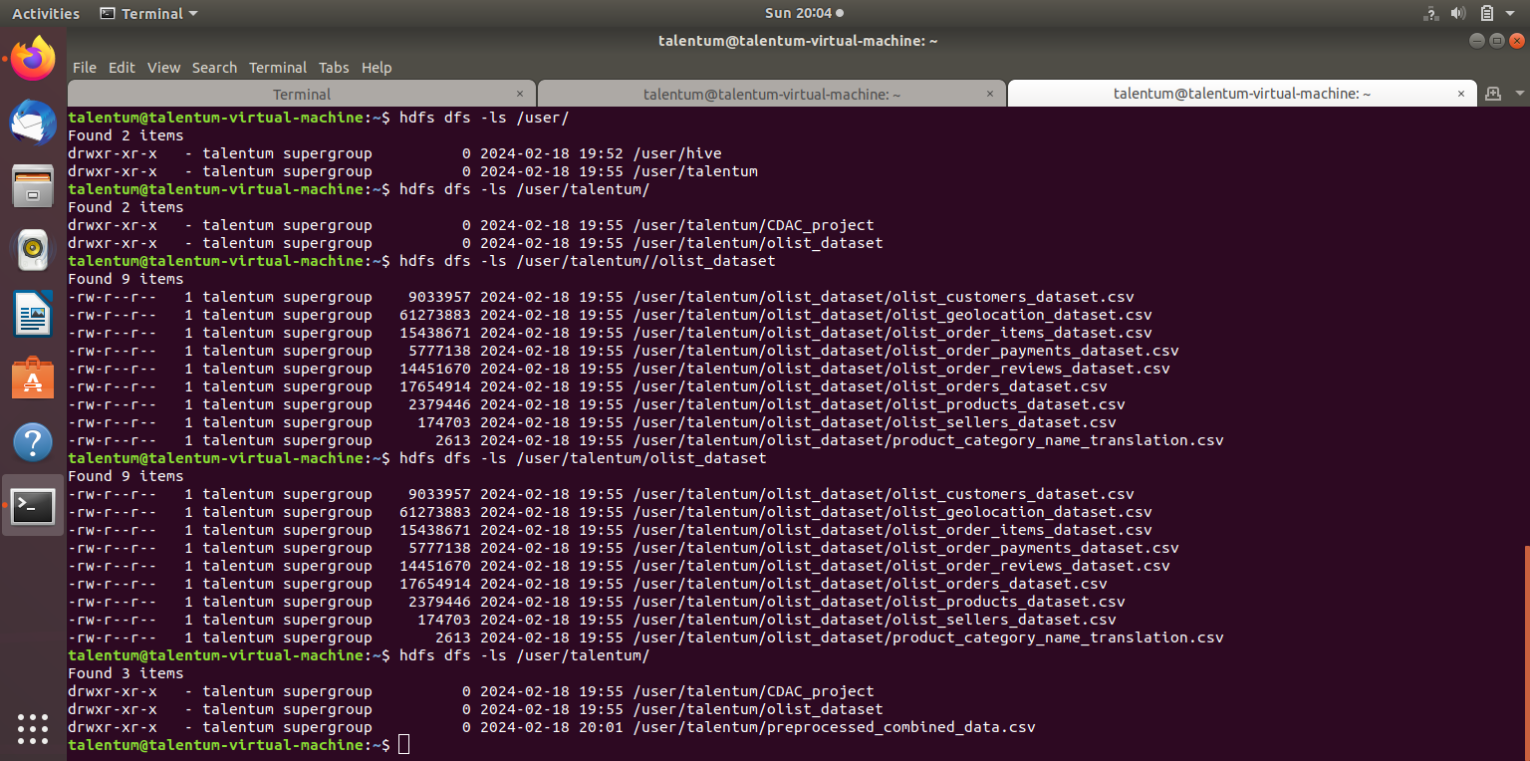
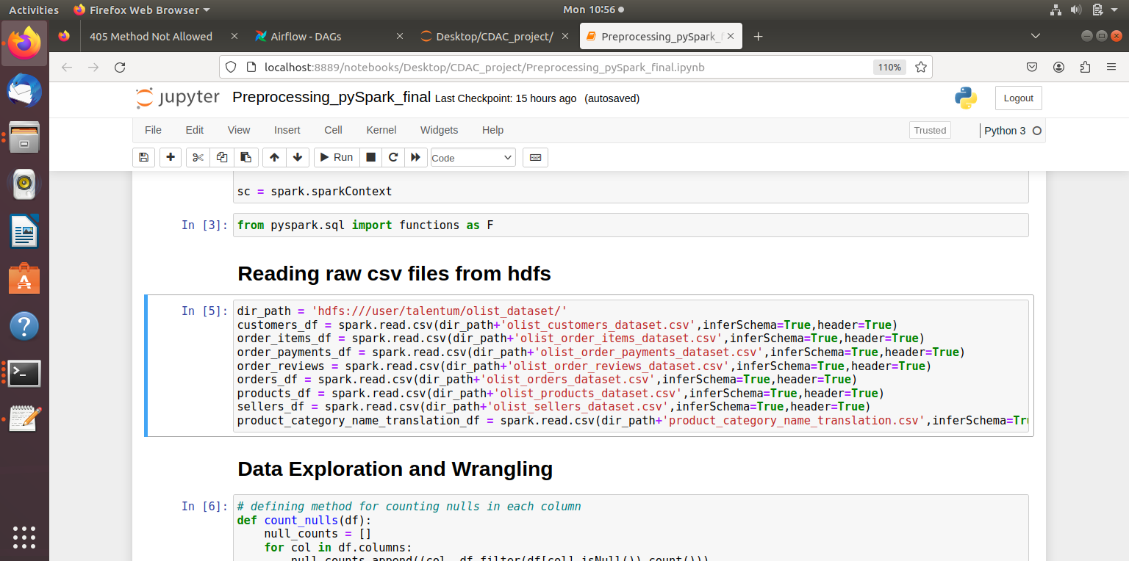
Data Extraction

Slide 7
Data Preprocessing - 1
Filtering-Out Irrelevant Records | Irrelevant records such as non-delivered orders, reviews without corresponding review/order ID, etc were removed from data
Dropping Irrelevant Columns | Project-irrelevant columns such as Review Message, Review Title, Latitude & Longitude, Pin Code, etc were dropped
Null Handling | Nulls rows were dropped or Null cells were replaced with values

Slide 8
Data Preprocessing - 2
Column Format Conversion | String date columns were converted to datetime format
Creating New Columns | Derived columns such as month, year, week and classification columns such as Delay/No Delay were created
Joining Data | Data is joined through keys
Storage | Data is stored in HDFS and Hive in CSV format

Slide 9
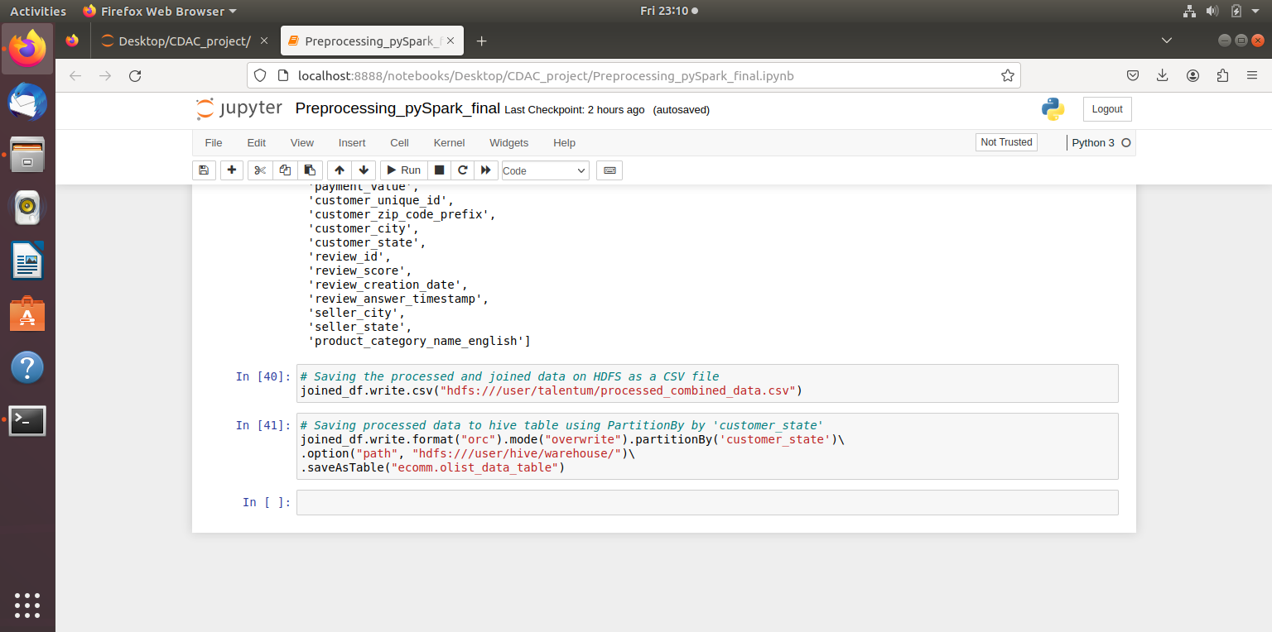

Data Warehousing

Slide 10
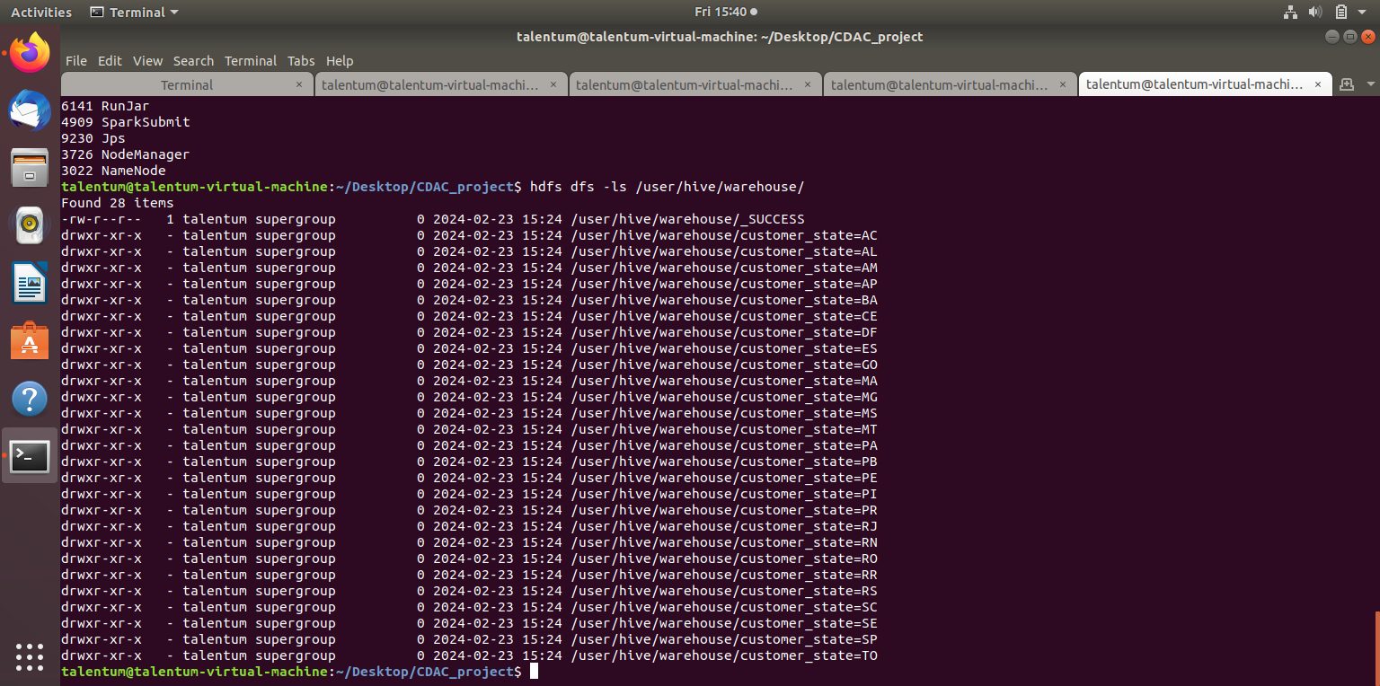
Data Warehousing

Slide 11
Dashboards & Metrics

Slide 12
Dashboards
Customer Preferences Dashboard
Preferred Payment Method by Time
E-commerce Trend Dashboard
Top 5 Product Categories
Order Volume by Time
Preferred Day of Week for Ordering
Sales by Time
Preferred Time of Day for Ordering
Number of Customers by Time
Preferred Product Price
Delivery Performance
Preferred Basket Size

Slide 13
Dashboards
Geographical Spread Dashboard
Review Analysis Dashboard
Customer Concentration by State & City
Swiftness of Review Creation
Seller Concentration by State & City
Swiftness of Review Reply
Order Concentration by State
Mean, Median, Mode Review Score
Top 5 Cities with Lowest Delivery Time
Percentage of Orders by Review Score
Top 5 Cities with Highest Delivery Delay
Effect of Delivery Delay on Review

Slide 14
Metrics
E-commerce Trend Metrics
Geographical Spread Metrics
Total Number of Customers
Number of Cities Serviced
Average Revenue per Customer
Avg. No. of Days to Deliver
Avg. No. of Orders per Customer
Percentage of Orders Delivered On-Time
Customer Preferences Metrics
Number of Product Categories
Review Analysis Metrics
Category Contributing Highest Revenue
Percentage of Orders Reviewed
Revenue Contribution of Top Category

Slide 15
Metrics
E-commerce Trend Metrics
Customer Preferences Metrics

Slide 16
Metrics
Geographical Spread Metrics
Review Analysis Metrics

Slide 17
Dashboard 1

Slide 18
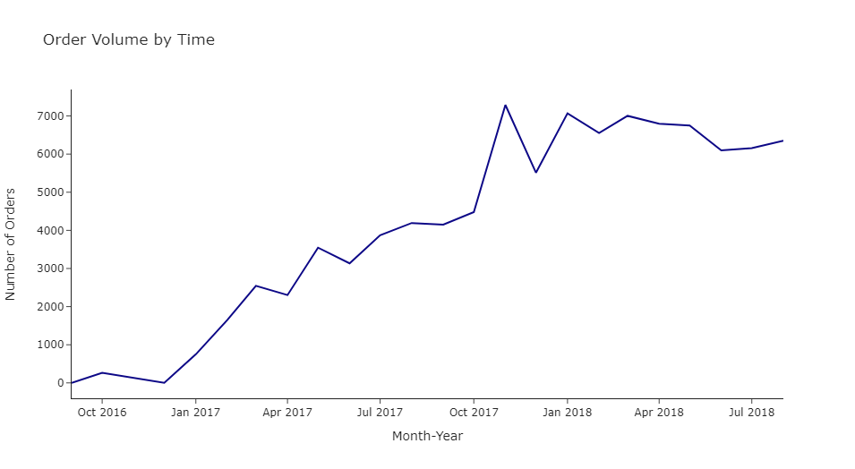
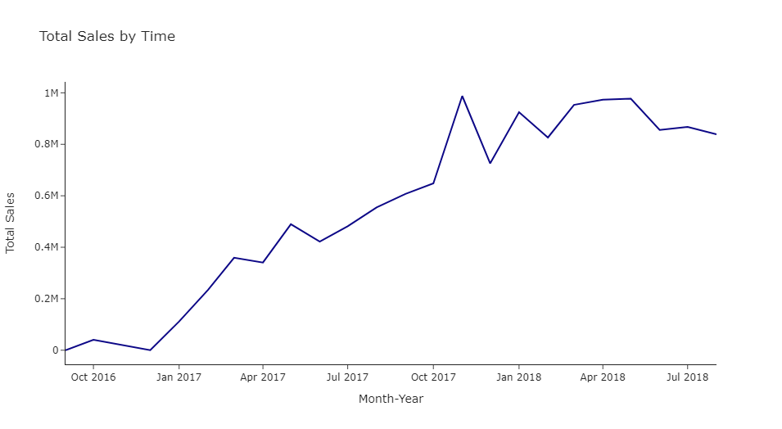
E-commerce Trend Dashboard - Part 1

Slide 19
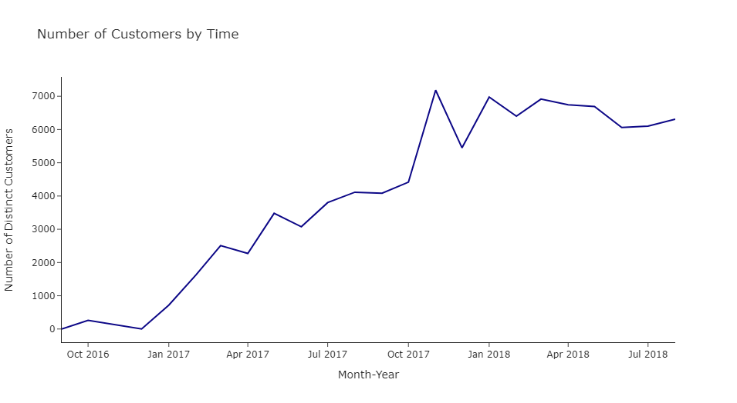
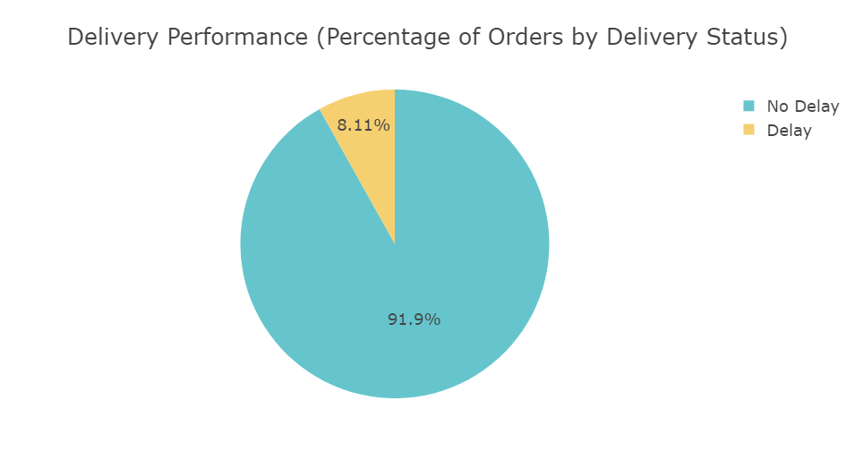
E-commerce Trend Dashboard - Part 2

Slide 20
Dashboard 2

Slide 21
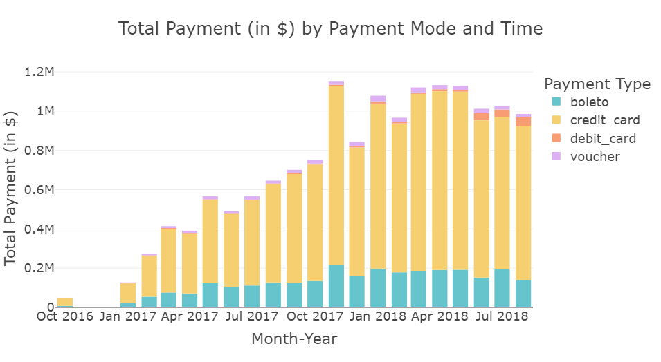
Customer Preference Dashboard - Part 1

Slide 22
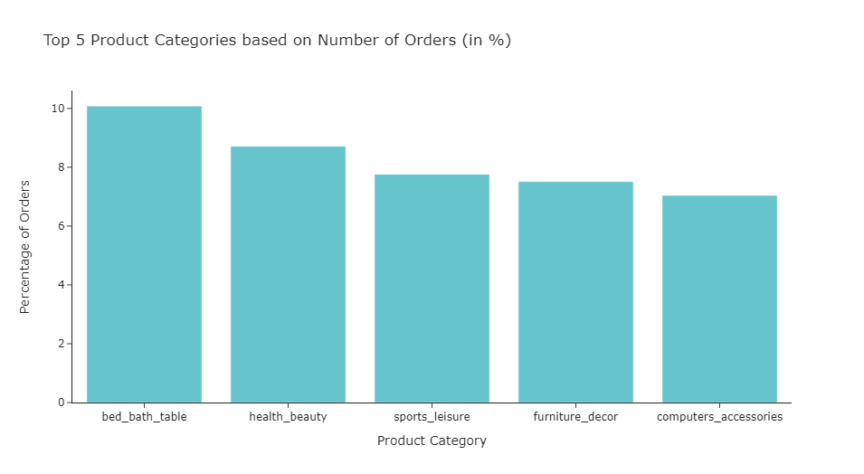
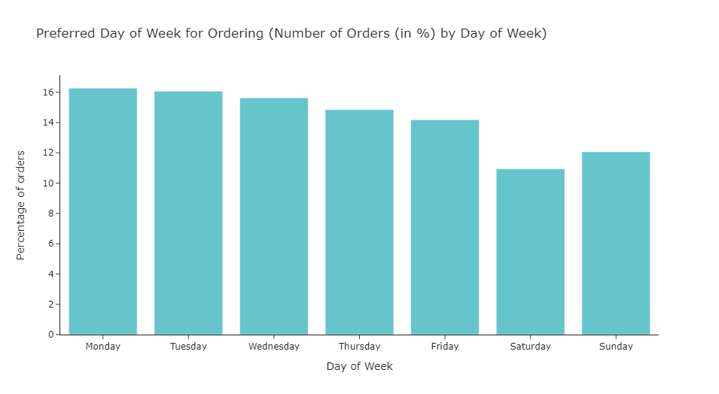
Customer Preference Dashboard - Part 2

Slide 23
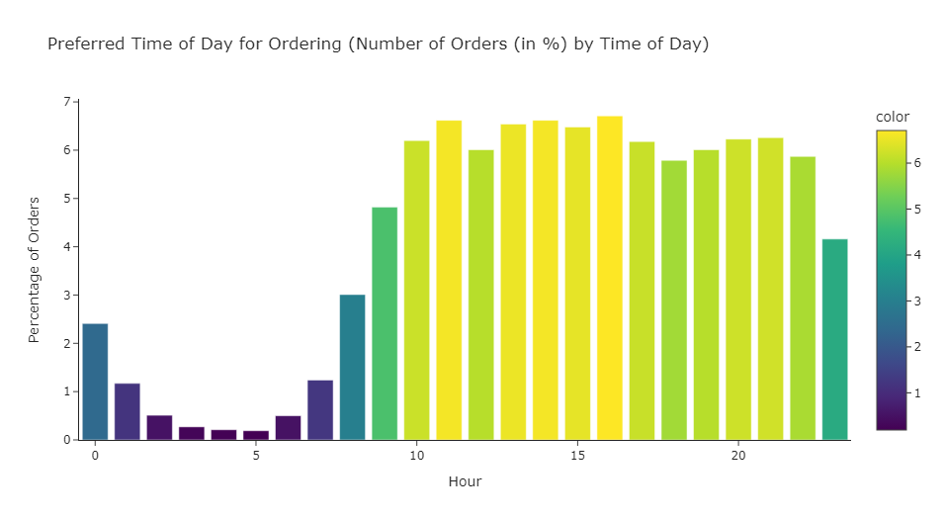
Customer Preference Dashboard - Part 3

Slide 24
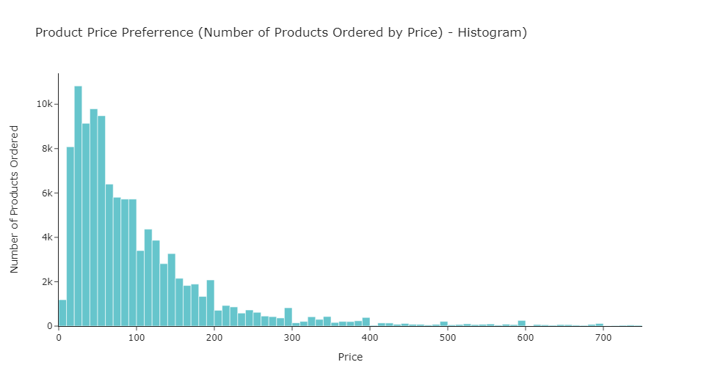
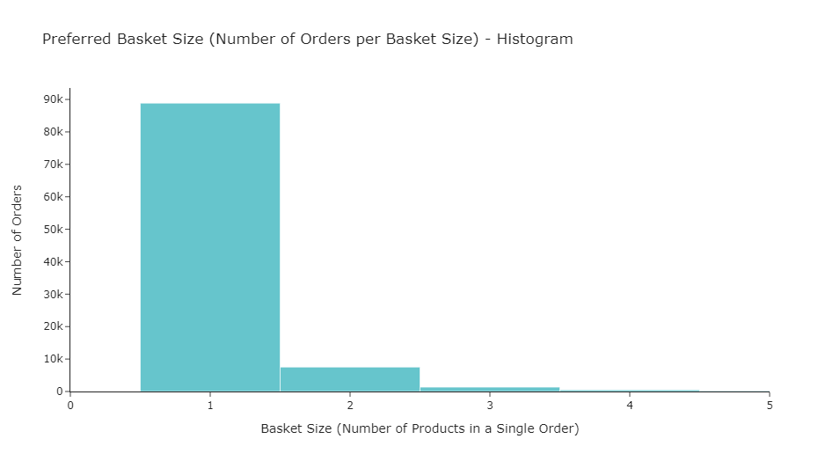
Customer Preference Dashboard - Part 4

Slide 25
Dashboard 3

Slide 26
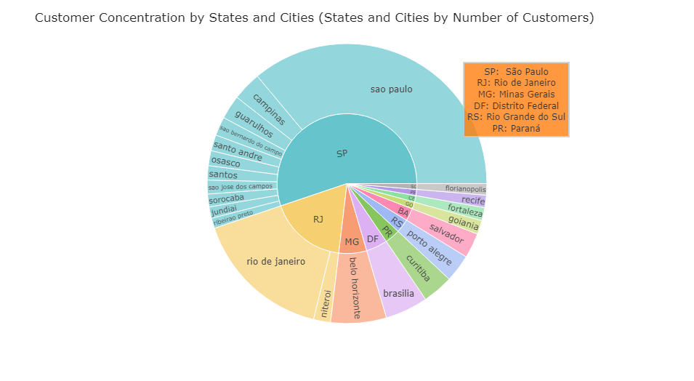
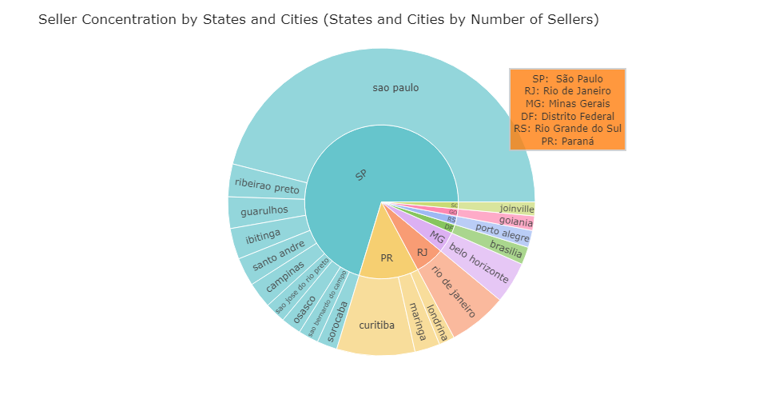
Geographical Spread Dashboard - Part 1

Slide 27
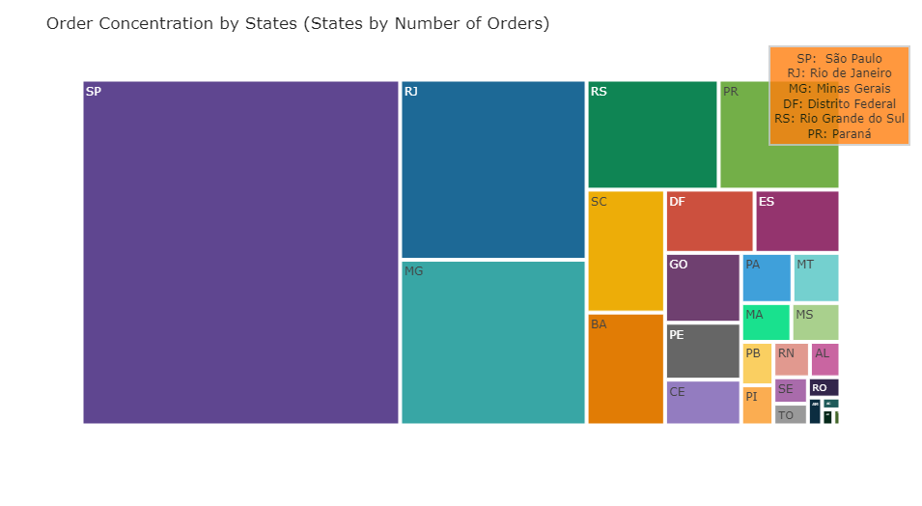
Geographical Spread Dashboard - Part 2

Slide 28
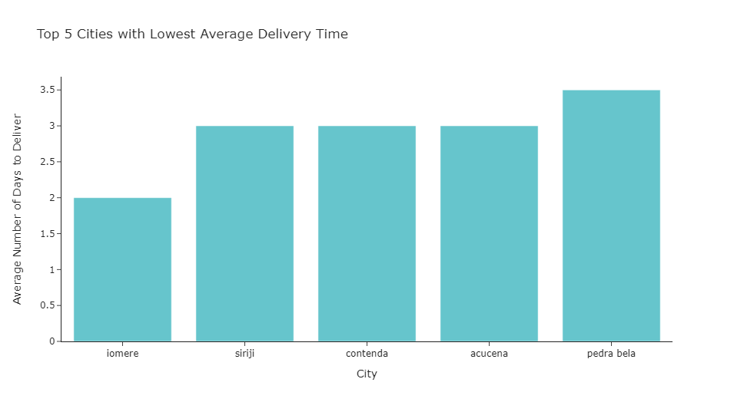
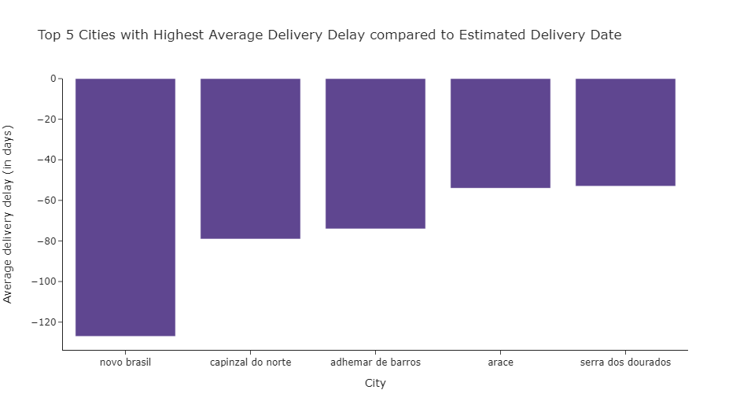
Geographical Spread Dashboard - Part 3

Slide 29
Dashboard 4

Slide 30
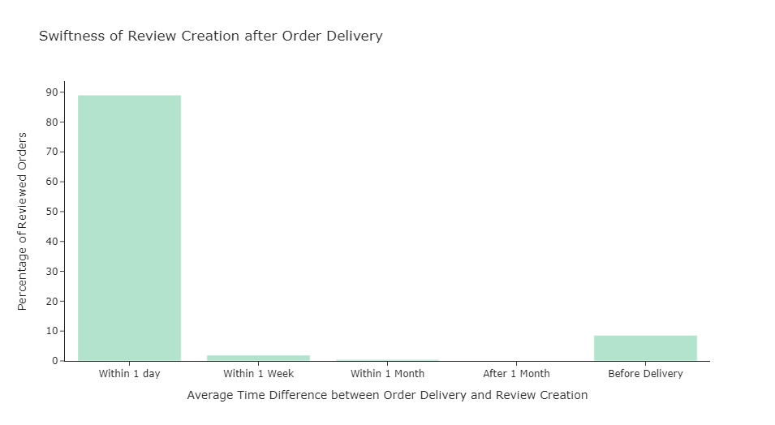
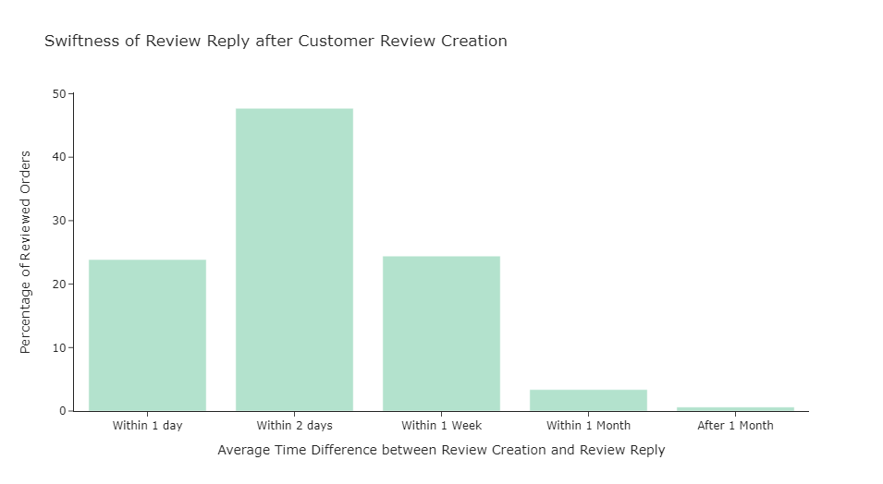
Review Analysis Dashboard - Part 1

Slide 31
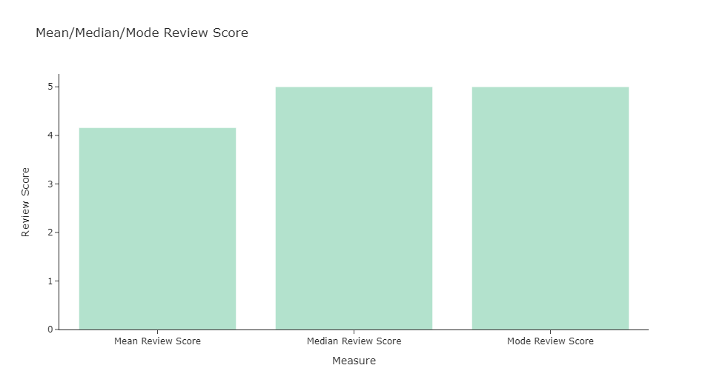
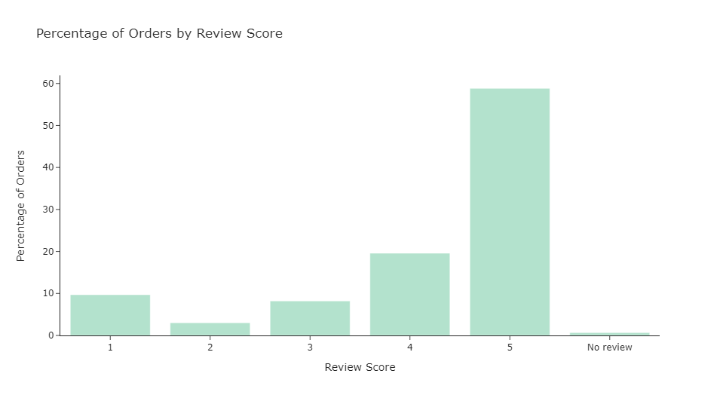
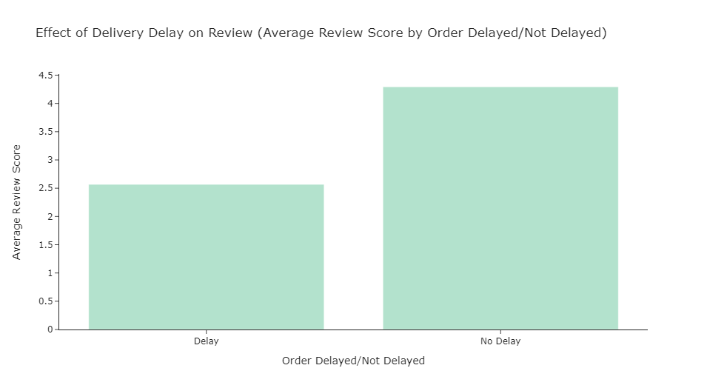
Review Analysis Dashboard - Part 2

Slide 32
RFM Analysis

Slide 33
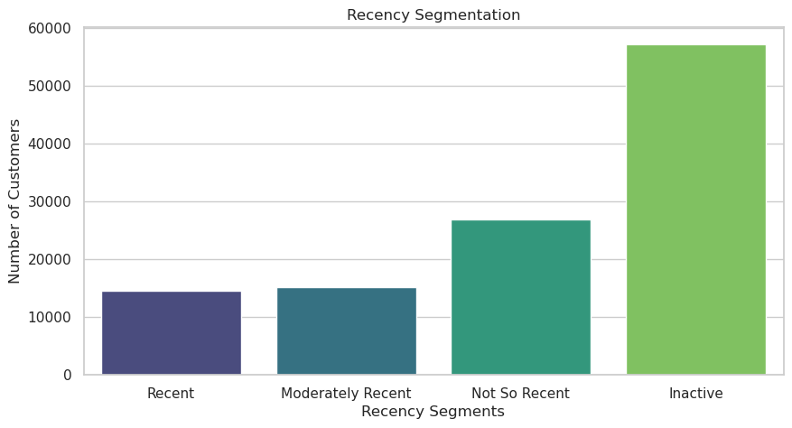
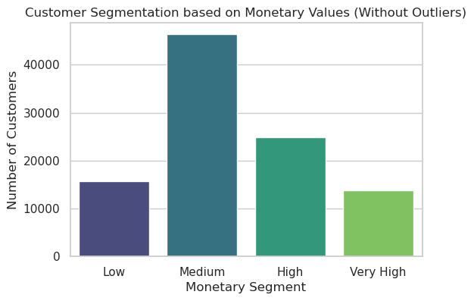
RFM Segmentation

Slide 34
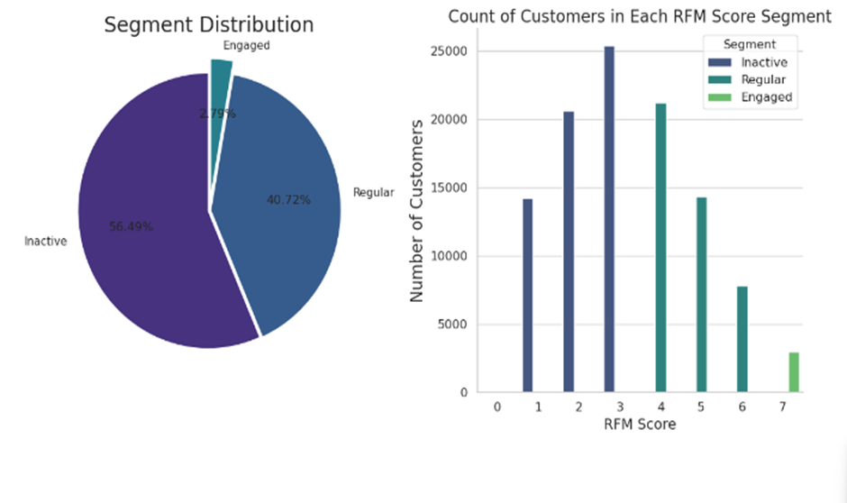
RFM Score Distribution

Slide 35
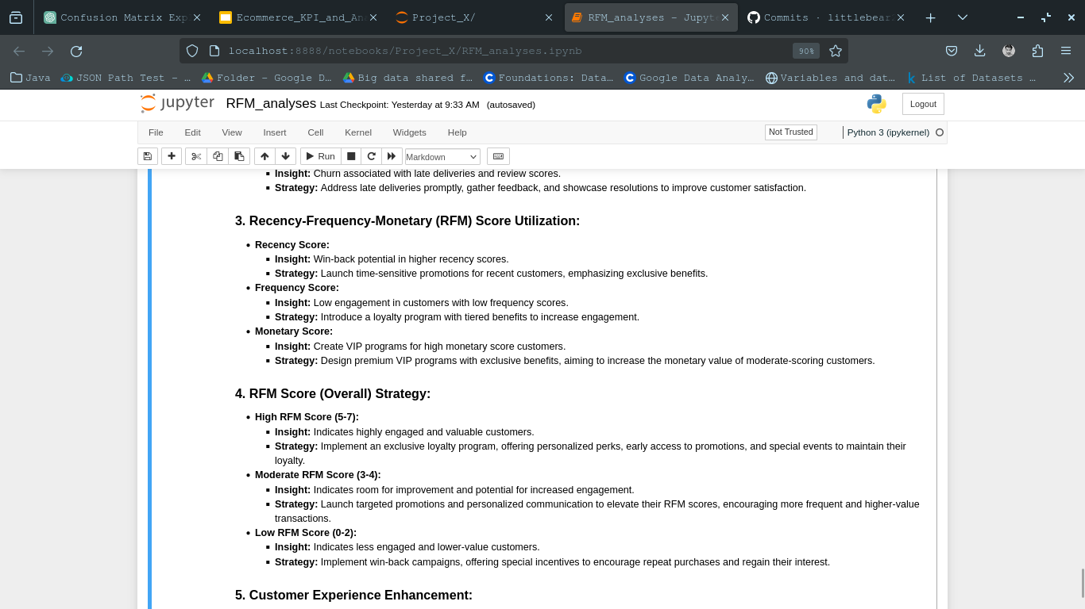
Customer retention
Why?
Acquiring a new customer can be five to 25 times more expensive than holding on to an existing one.

Slide 36
Churn Prediction Model

Slide 37
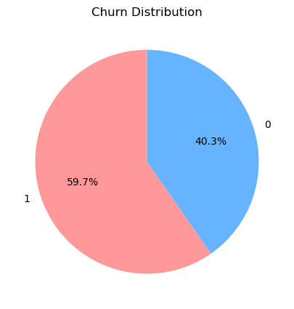
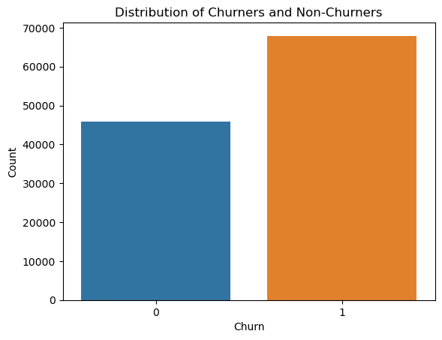
Churn Model

Slide 38
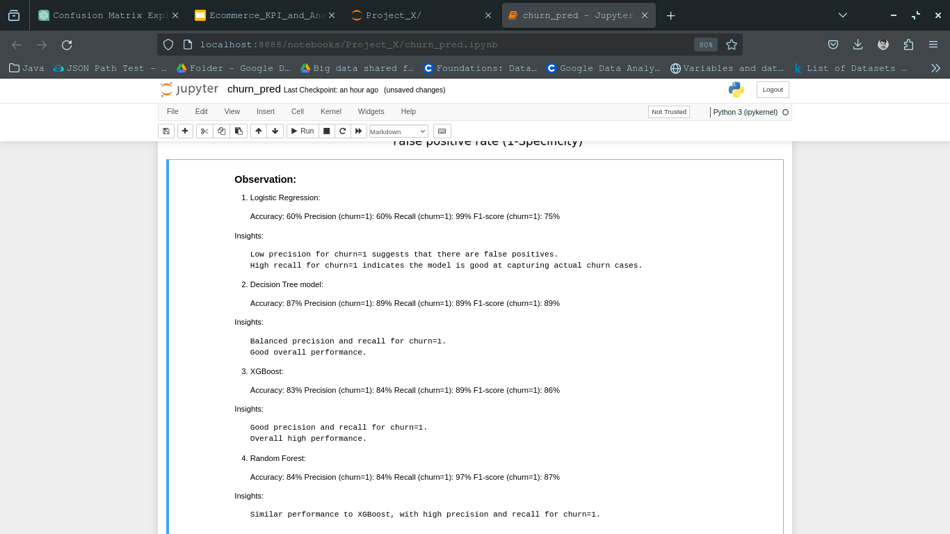
Churn Model Assessment - 1

Slide 39
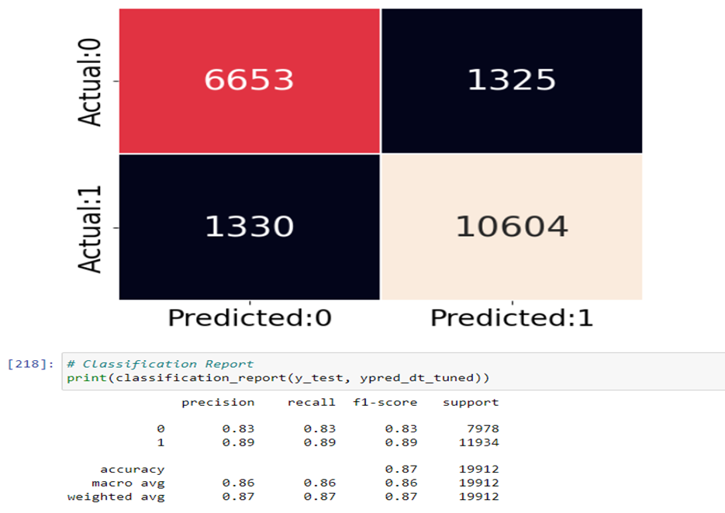
Churn Model Assessment - 2

Slide 40
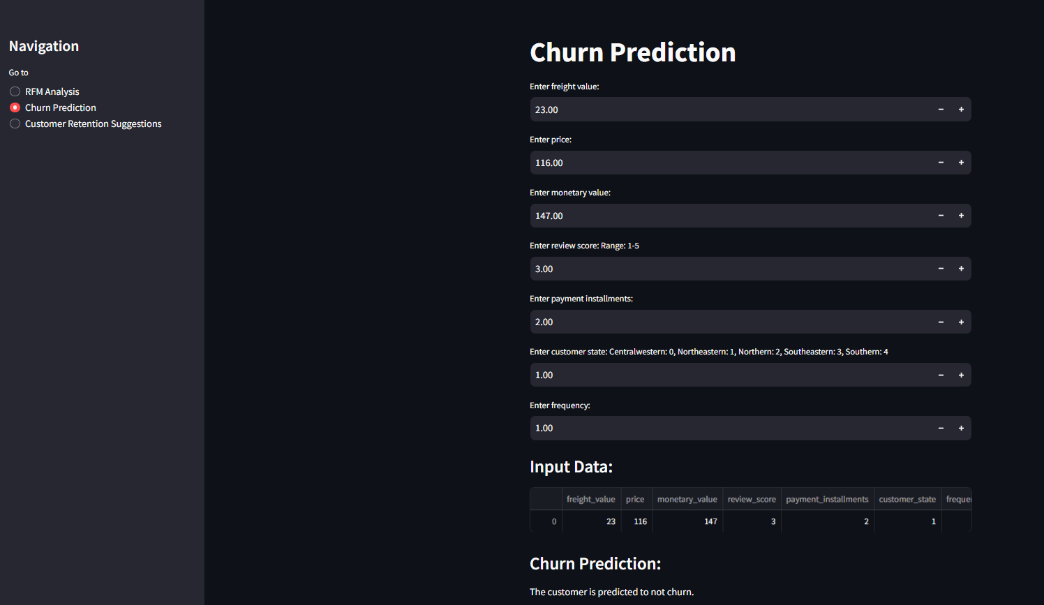
Churn Predictor User Interface

Slide 41
Recommendation System

Slide 42
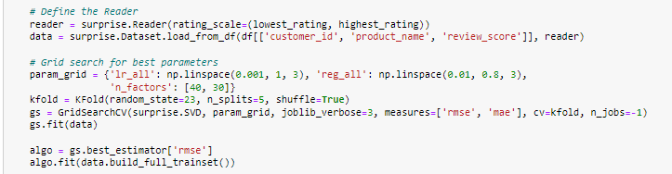
Recommendation System Model

Slide 43
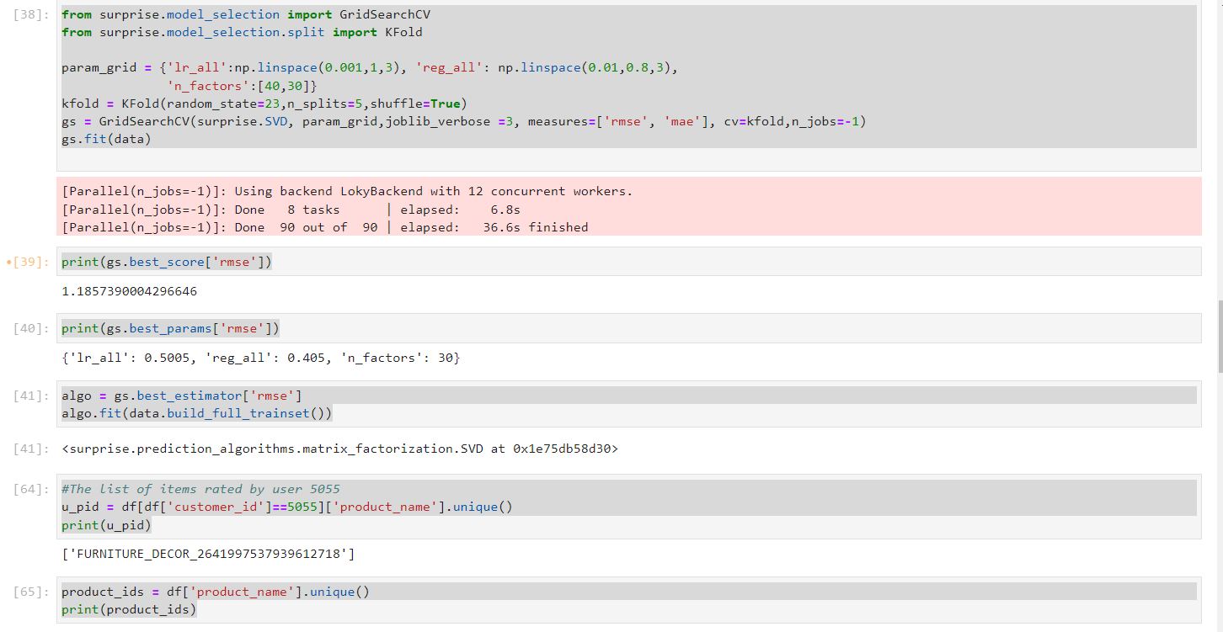
Recommendation System - Assessment

Slide 44
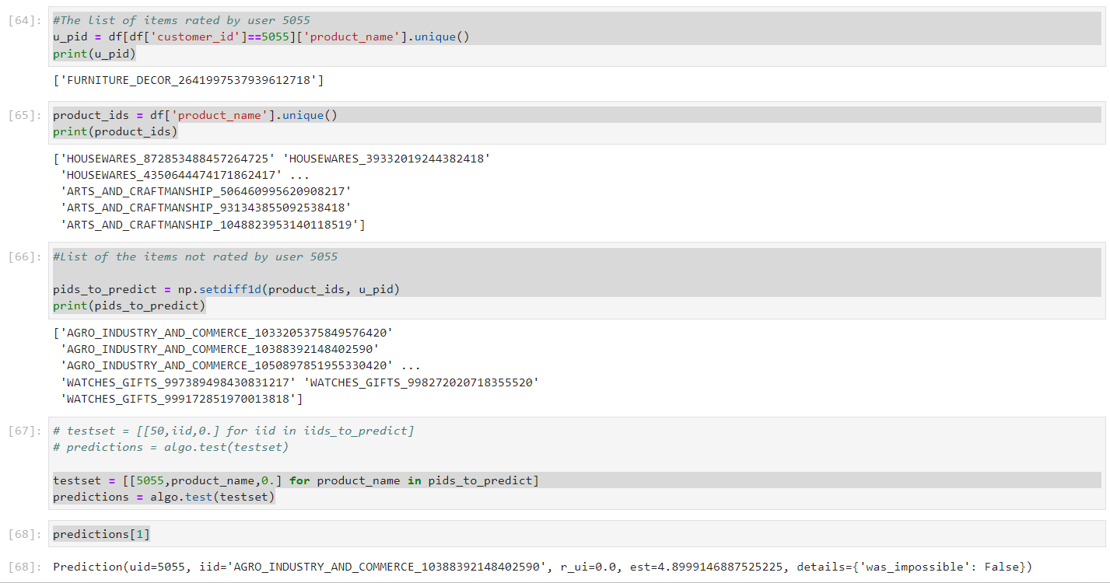
Recommendation System - Trial Run

Slide 45
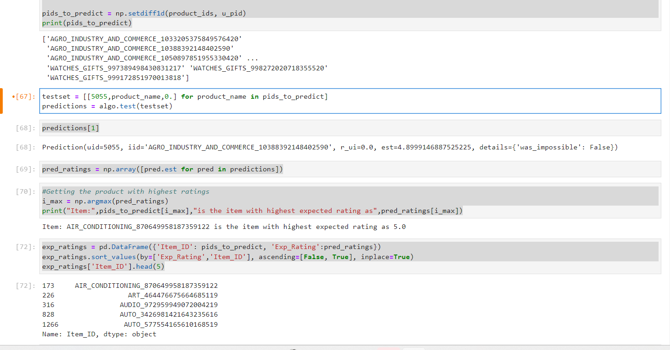
Recommendation System - Trial Run

Slide 46
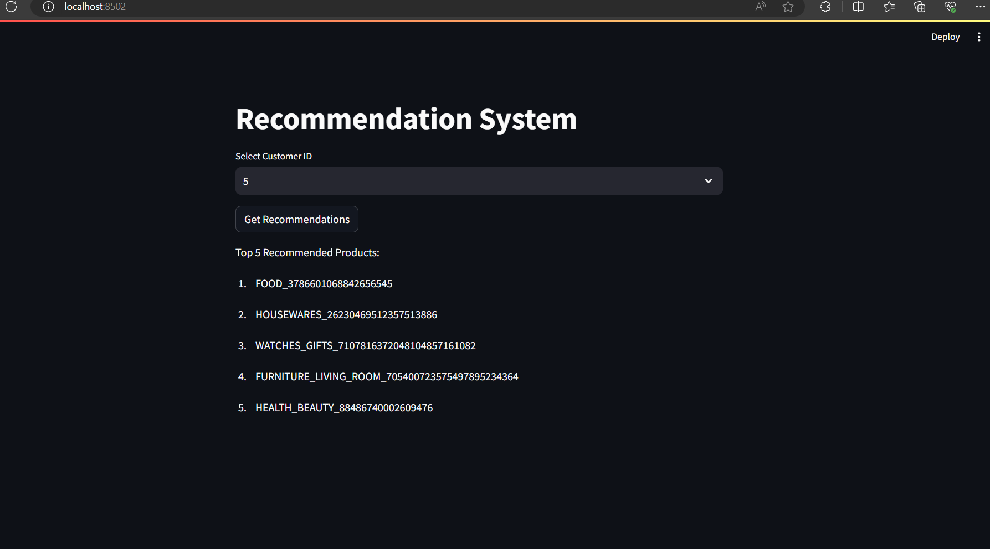
Recommendation System User Interface

Slide 47
Problems And Challenges Faced
Apache Airflow (Spark-submit)
Kafka
Dependencies issues

